Slide 1

dVRK Si Controller Assembly Instructions
v1.02
Johns Hopkins University
August 20, 2025

Slide 2
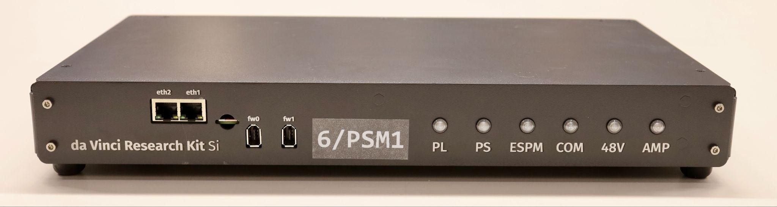
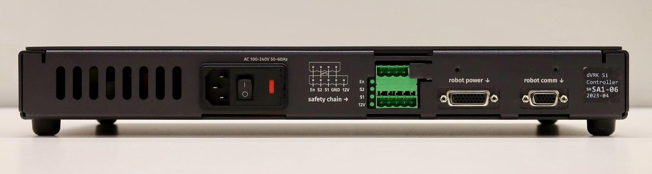
Exterior

Slide 3
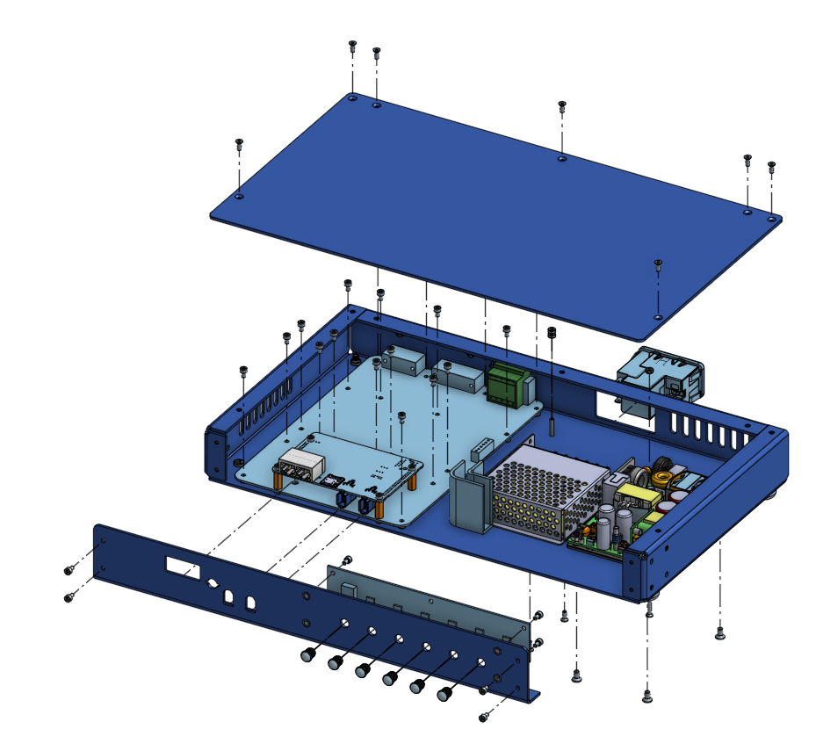
Enclosure

Slide 4
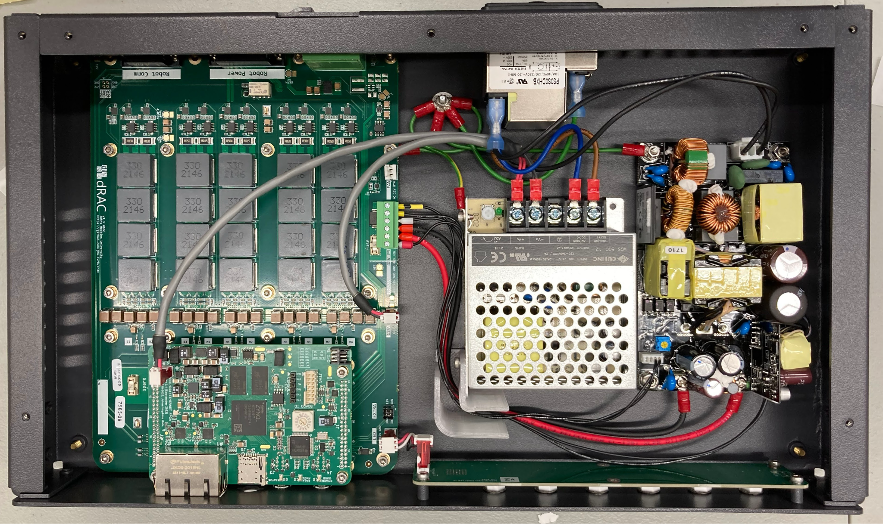
Electronic parts
106
101 dRAC
102 FPGA
103 Front panel LED
104 12V PS
105 48V PS
106 Power entry module
107 Light pipes (x6)
101
105
104
102
103
107

Slide 5
Wire harness assemblies
201
203
204
202
201
205
206
207

Slide 6
Wire harness assemblies

Slide 7
Notes
Substitution of connector styles (crimp vs IDC, vertical vs horizontal) is acceptable. Please be aware of the vertical space in the enclosure.
Substituting precrimped wires with custom crimped wires is acceptable.
Using colored wires in place of heat shrink markers is preferred.
Tapes in the photos are not part of the wiring harnesses.

Slide 8
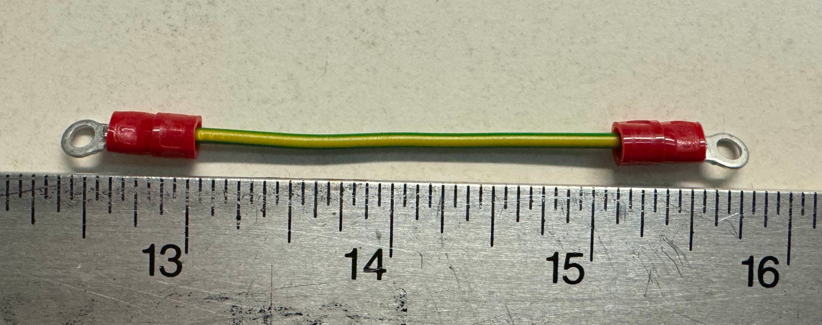

201 wire harness assy, earth 1 (qty 2)
101
Earth stud
104
M3
277-11117-ND
M3 16-20 AWG ring
16 AWG
Yellow/green
Mains voltage
M3
277-11117-ND
M3 16-20 AWG ring

Slide 9
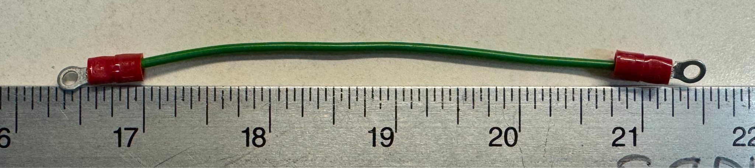
202 wire harness assy, earth 2
Earth stud
105
M3
277-11117-ND
M3 16-20 AWG ring
16 AWG
Yellow/green
Mains voltage
M3
277-11117-ND
M3 16-20 AWG ring

Slide 10
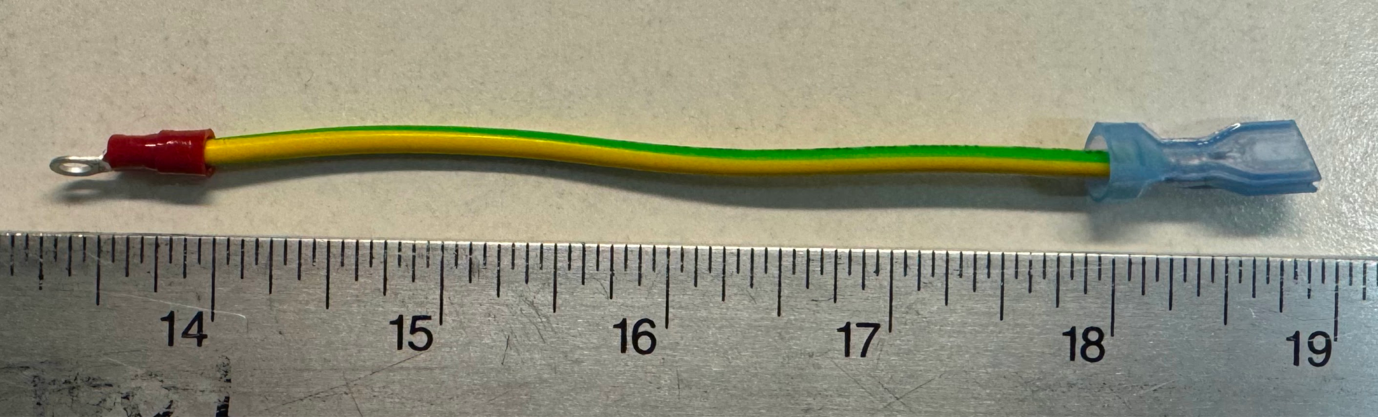
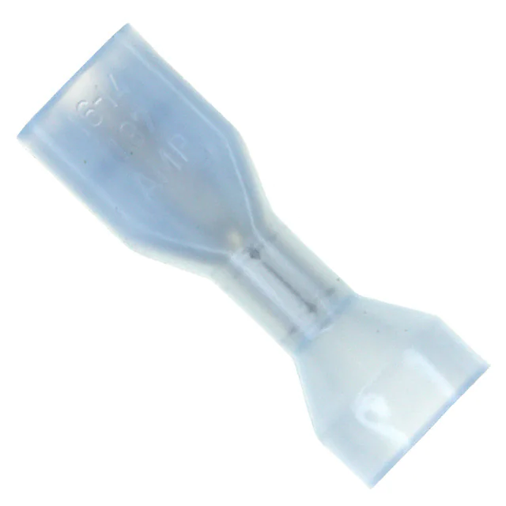
203 wire harness assy, earth 3
106
Earth stud
M3
277-11117-ND
M3 16-20 AWG ring
16 AWG
Yellow/green
Mains voltage
A27815CT-ND
14-16 AWG

Slide 11
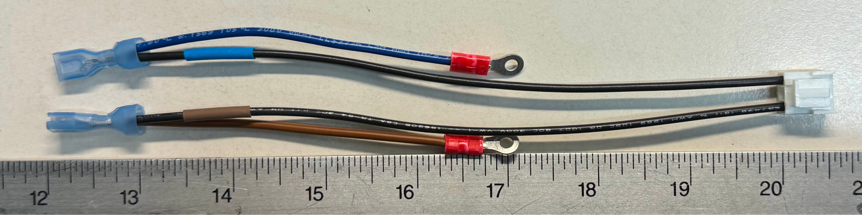
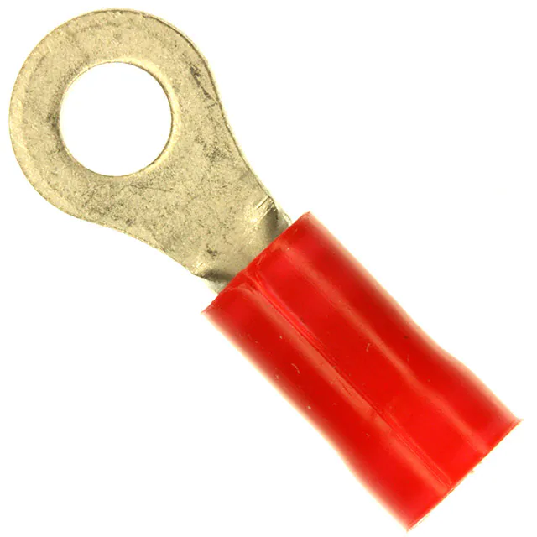
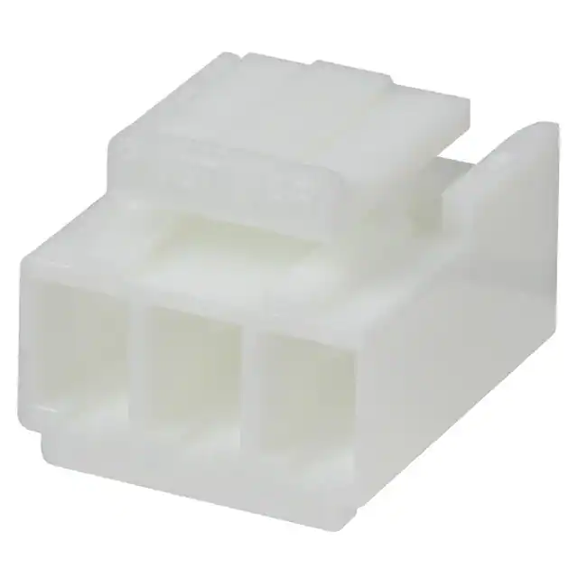
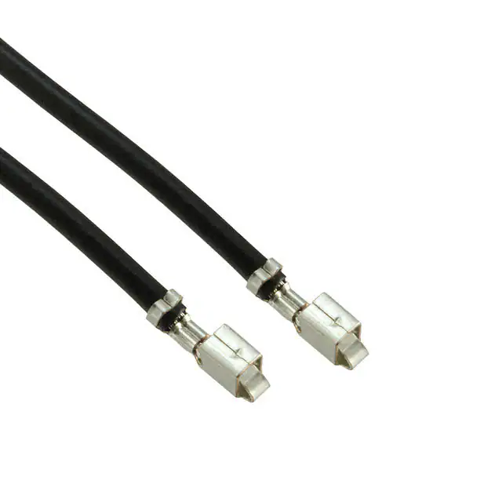
204 wire harness assy, AC
N
104
105
106
L
A27815CT-ND
14-16 AWG
M3.5
A0956-ND
M3.5 16-22 AWG ring
455-3982-ND
VHR 3 pin
455-3107-ND
Precrimped VHR 16 AWG
(N) Blue 18 AWG
(L) Brown 18 AWG
Mains voltage

Slide 12
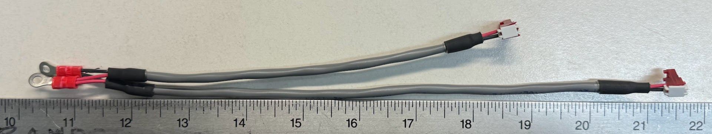
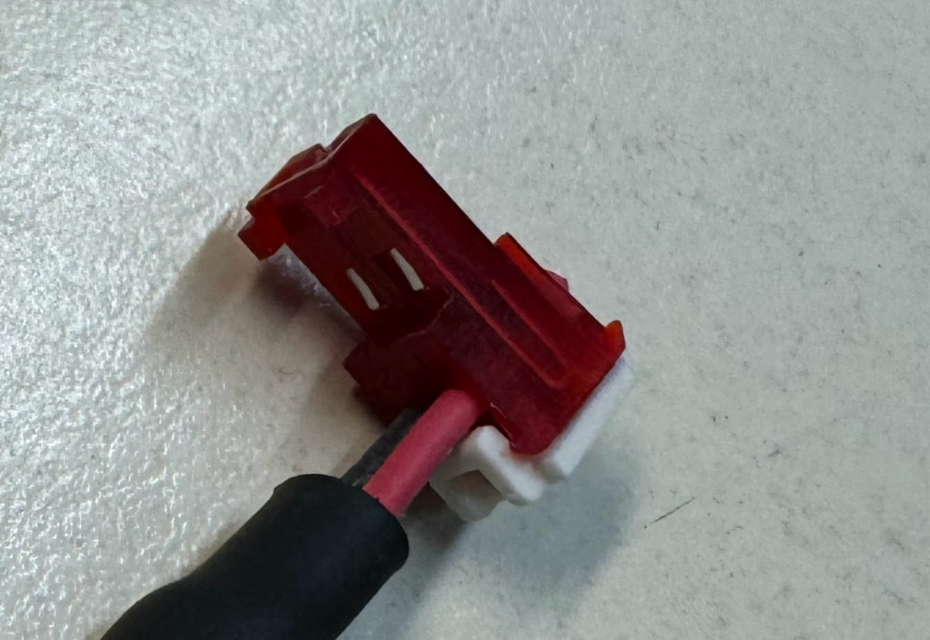
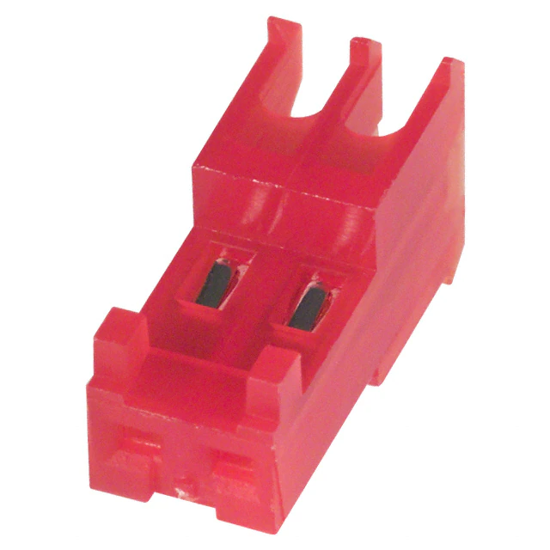
205 wire harness assy, 12V
101
104
102
M3.5
A0956-ND
M3.5 16-22 AWG ring
A31120-ND
A19270-ND (cover)
MTA-100 2 pin
22 AWG
2C wire, 22 AWG

Slide 13
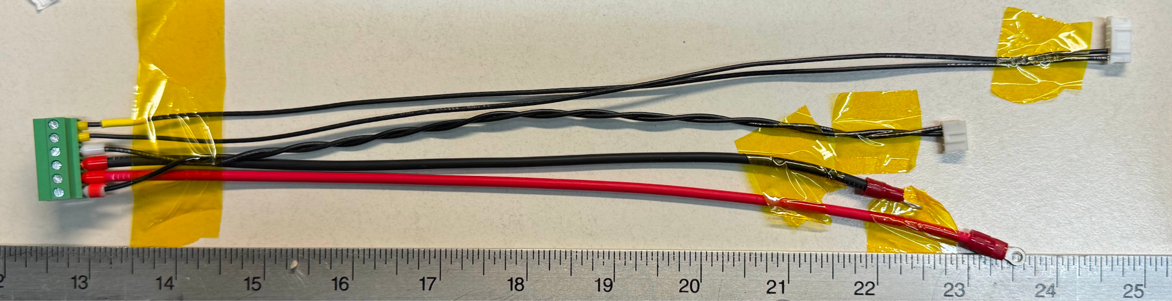
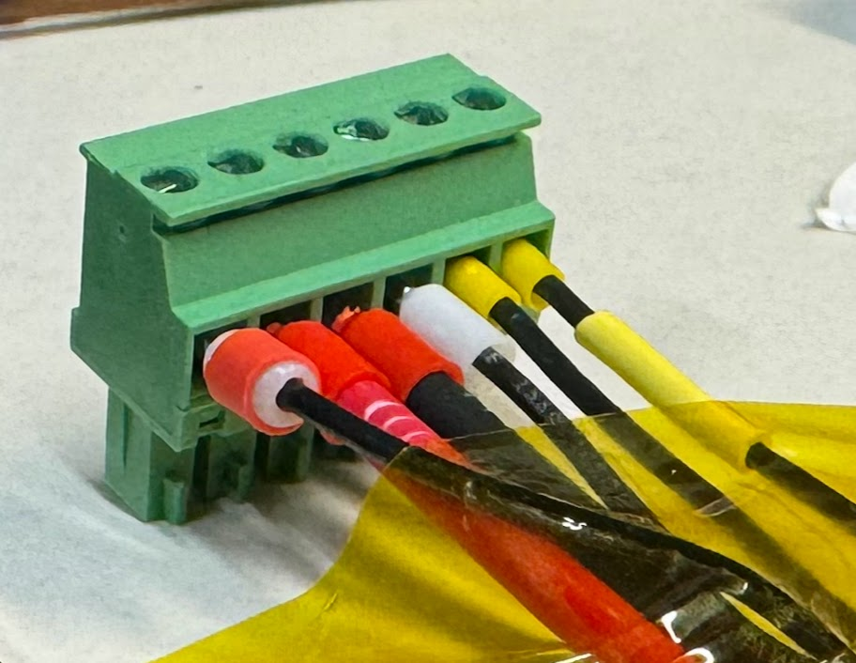
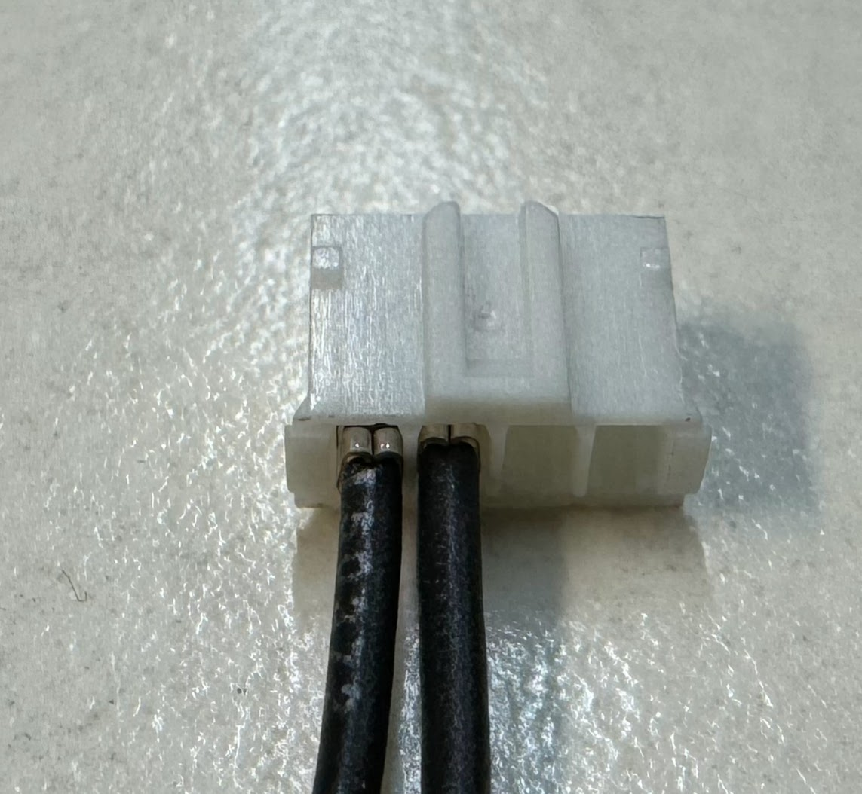
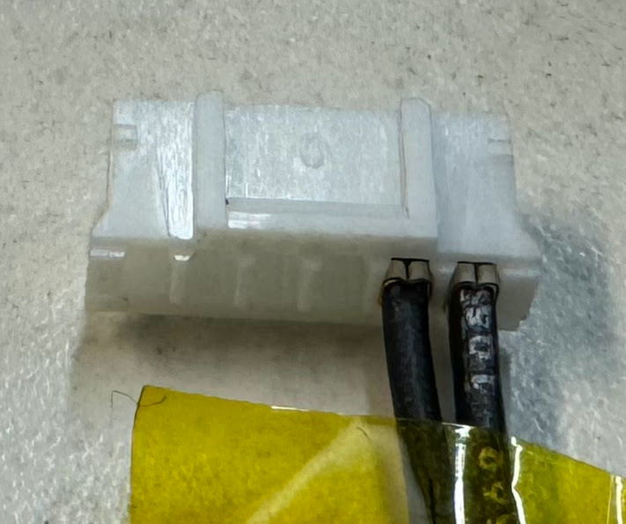
206 wire harness assy, 48V
105
101
1
2
2
6
1
3
3
4
5
4
6
5
6
3
2
1
If same color wires are used:
Apply yellow heat shrink to wire 1
Apply red heat shrink to wire 6
(picture shows on ferrule. Prefer on the wire.)
See next page

Slide 14
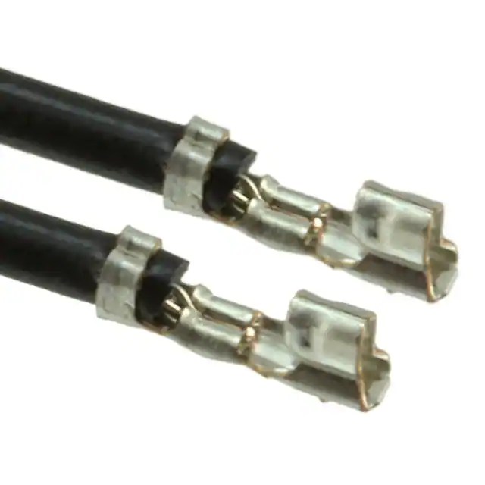
206 wire harness assy, 48V - wires
Must be twisted
Twist before inserting into the screw terminal
Precrimped
455-3083-ND
PH 24 AWG
(48V+) Red 16 AWG
(48V-) Black 16 AWG
See next page

Slide 15
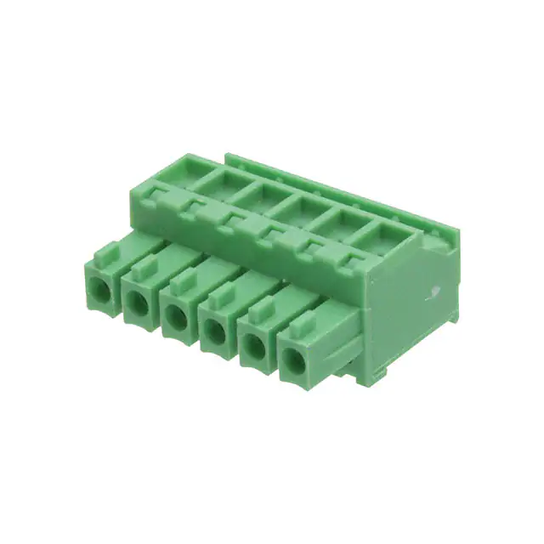
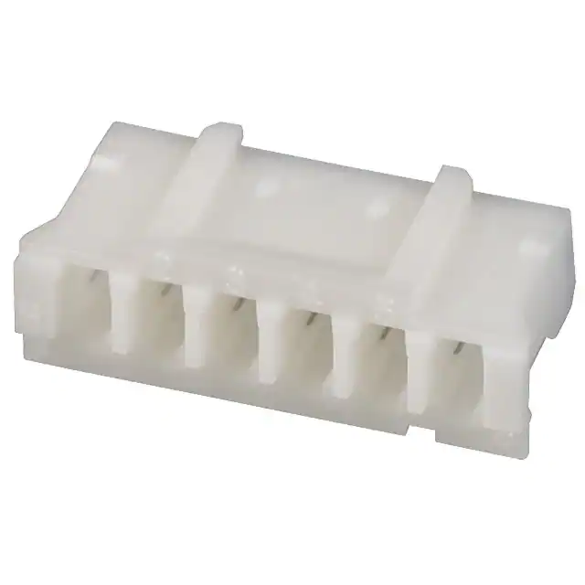
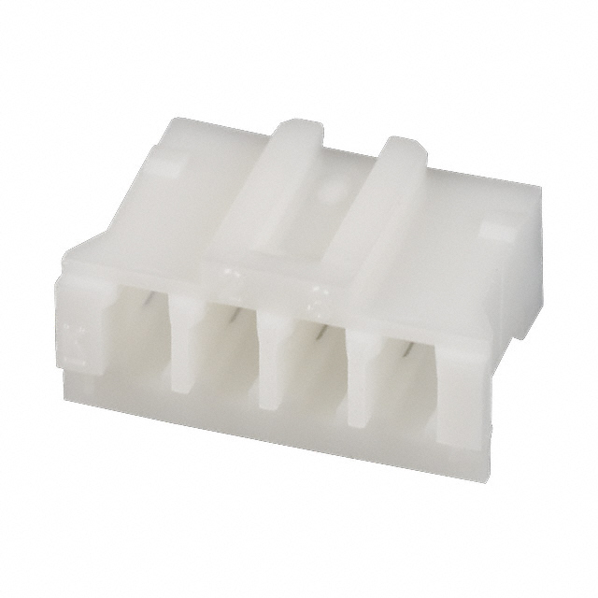
206 wire harness assy, 48V - connectors
732-691363310006-ND
cheaper alt: 609-3790-ND
Hook on wire side
28-16 AWG / 0.081-1.31 MM²
TORQUE: 1.7 Lb-In / 0.2 Nm
277-2190-ND
16 AWG Ferrule
298-10284-ND
24 AWG Ferrule
455-1162-ND
PH 6 pin
455-1164-ND
PH 4 pin
M3
277-11117-ND
M3 16-20 AWG ring

Slide 16
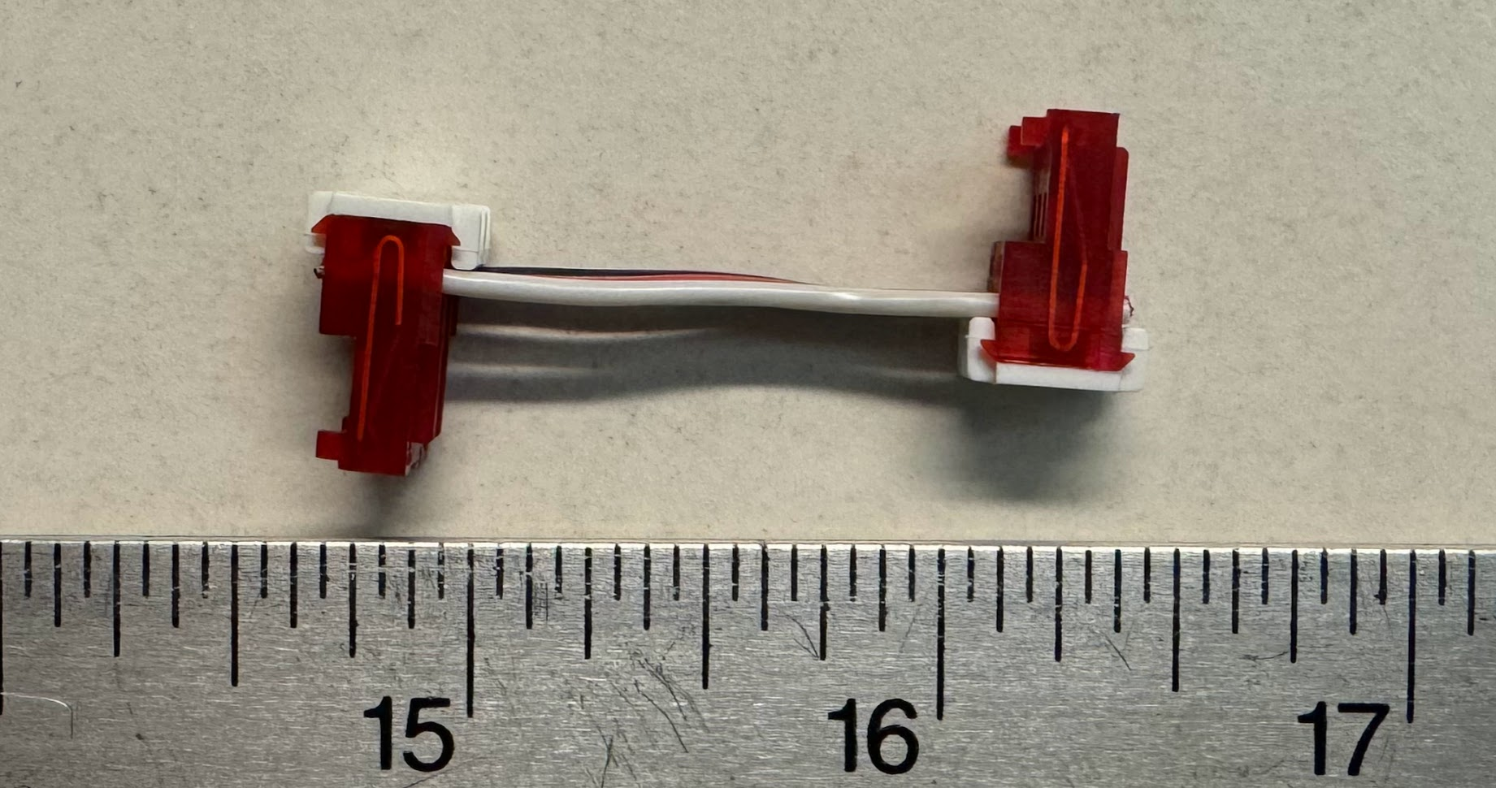
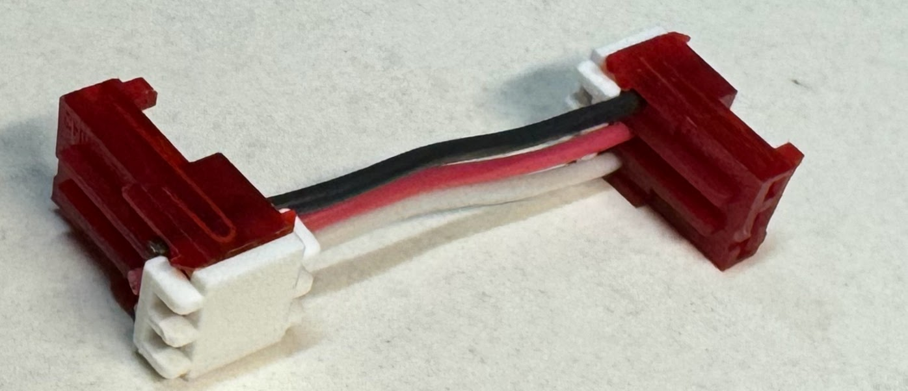
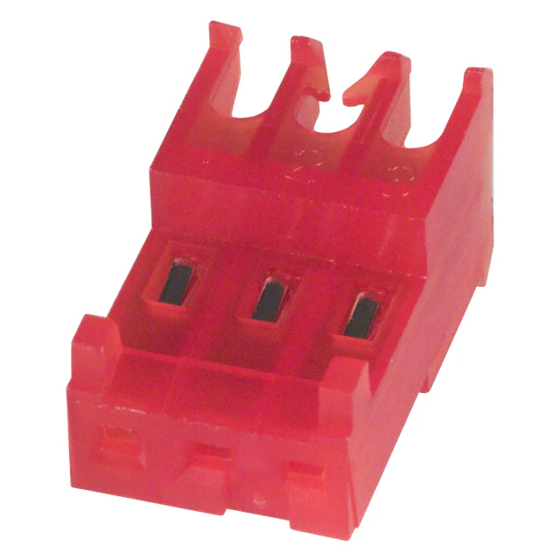
207 wire harness assy, front panel
102
103
A31121-ND
A19271-ND (cover)
22 AWG
Black, red, white 22 AWG

Slide 17
Assembly Instructions

Slide 18
Notes
All screws and D-sub screwlocks must be installed with purple threadlocker or have a pre-applied nylon patch.

Slide 19
Step 1. Preparation
Assemble all wire harness assemblies
Assemble front panel
Assemble power entry module with wires
Assemble 12V power supply with earth wire and cable guide
Attach FPGA to dRAC

Slide 20
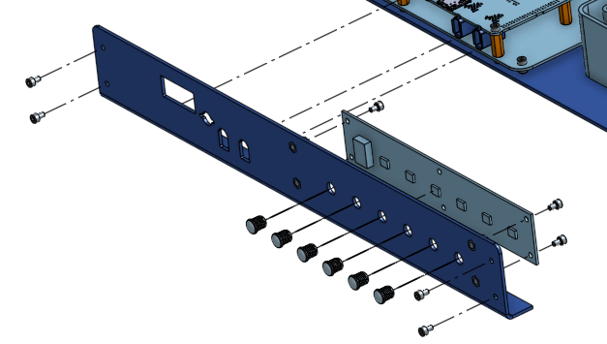
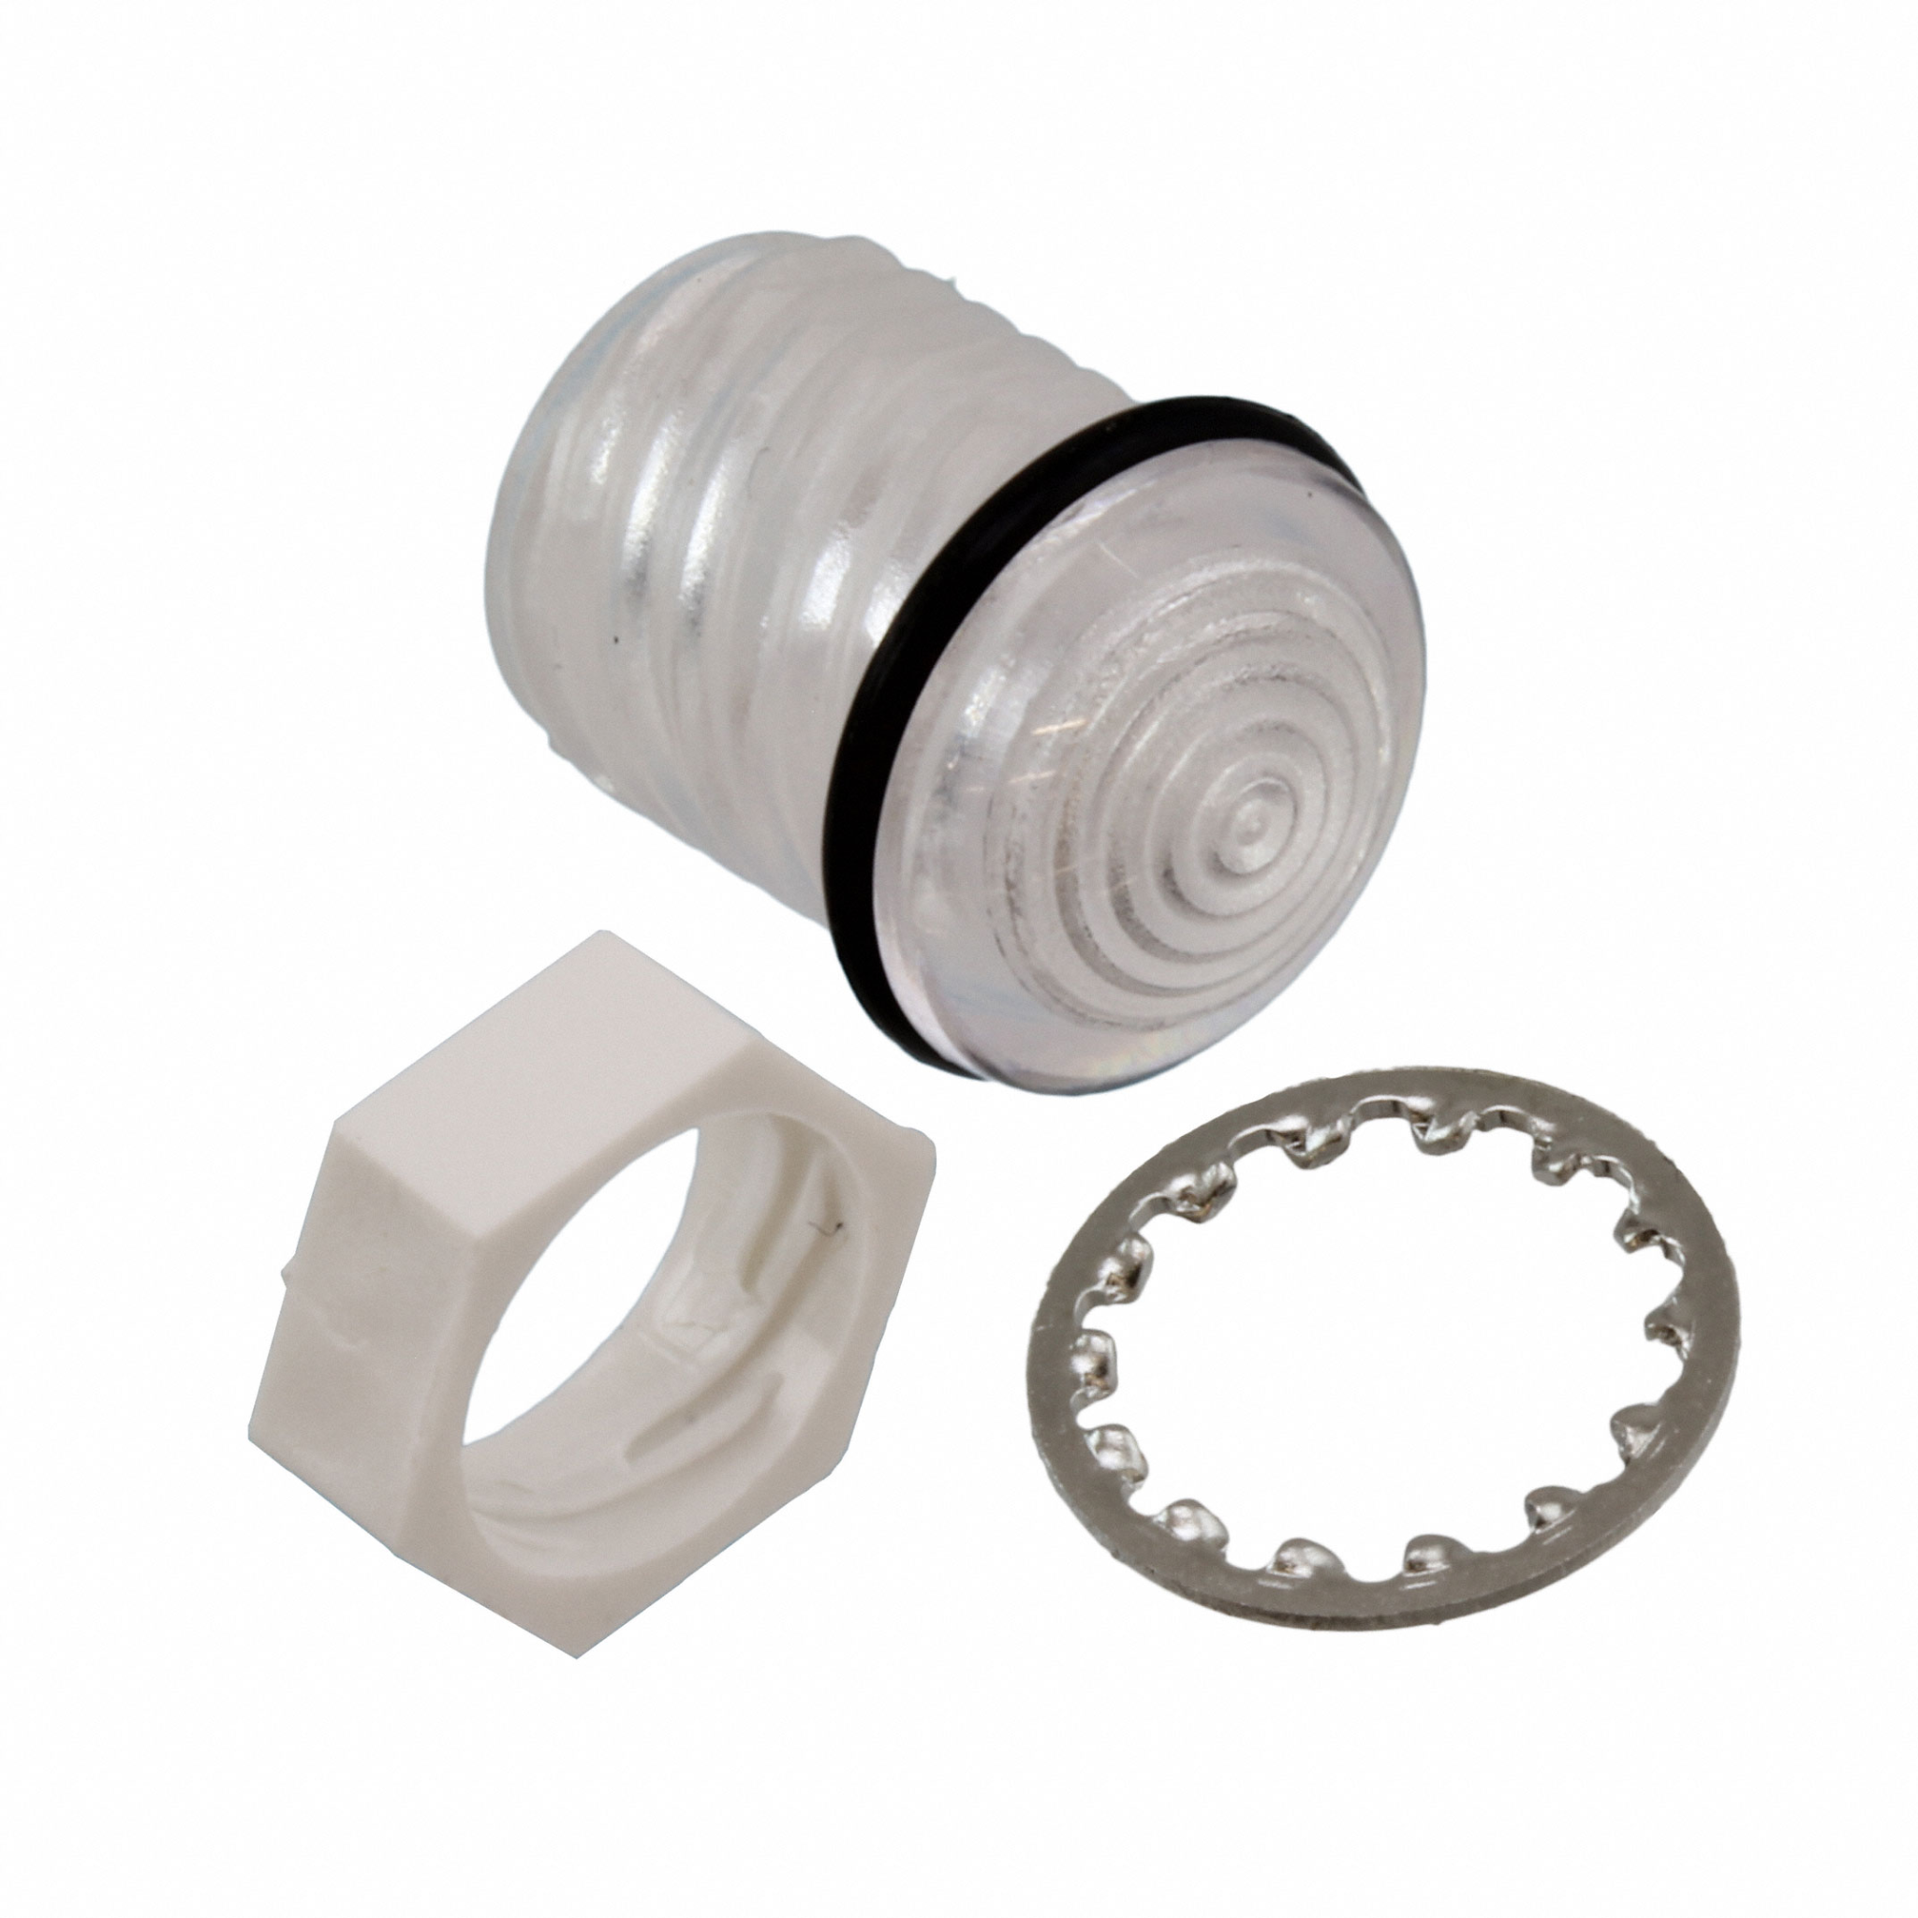
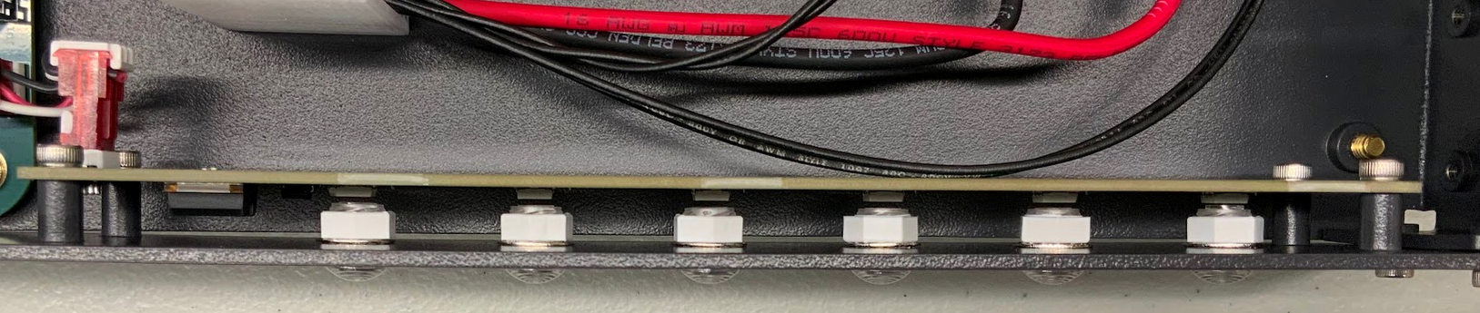
Assemble front panel
403
107
301
M3x5
107
103
Plastic nut
Lock washer
======
Panel
======
Gasket
Light pipe
Connector on left side

Slide 21
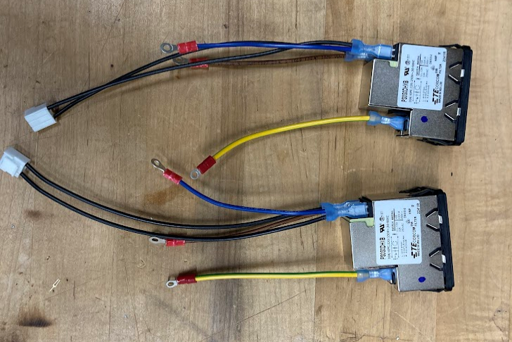
Assemble power entry module with wires
204
106
It is easier to plug in the wires to the power entry module before putting the power entry module in the case.
203

Slide 22
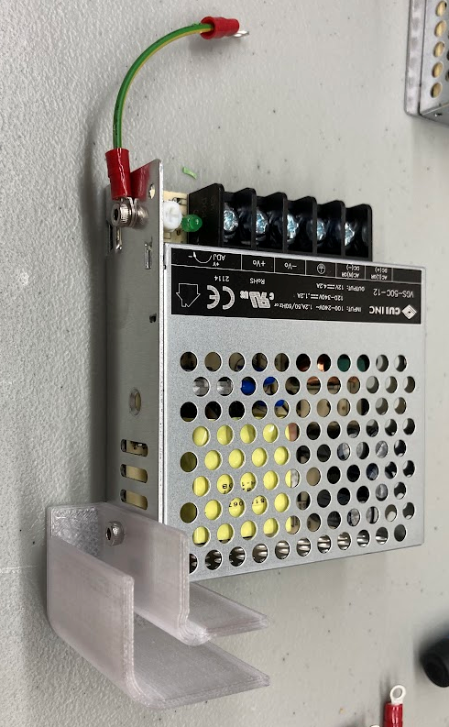
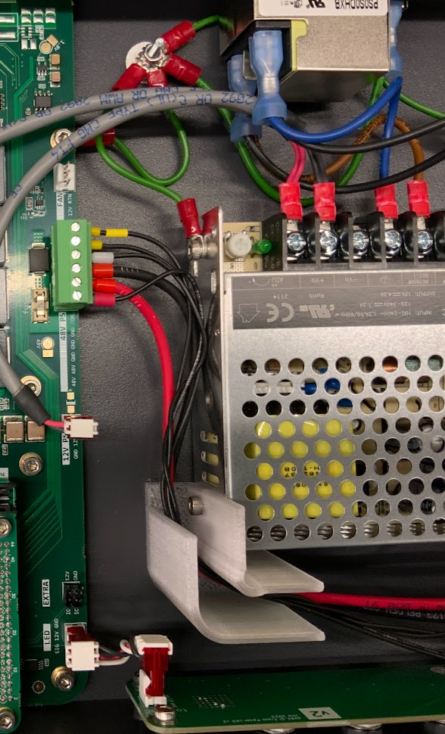
Assemble 12V power supply with earth wire and cable guide
201
Use the aluminum panel for earth connection. The earth screw terminal is not used.
Attach the earth wire and the wire guide before attaching the power supply to enclosure.
M3x5
301
104
M3x5
405

Slide 23
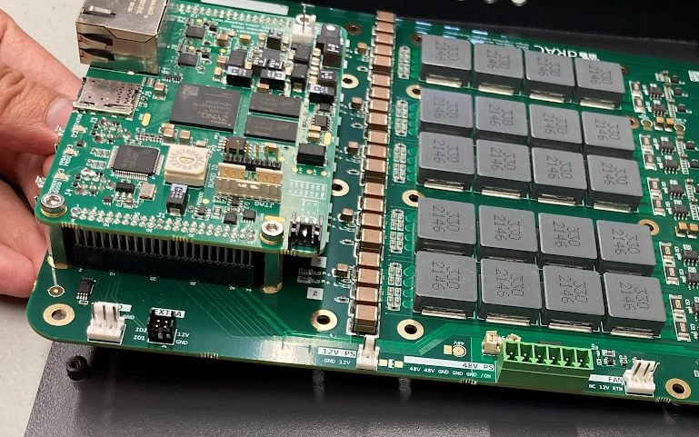
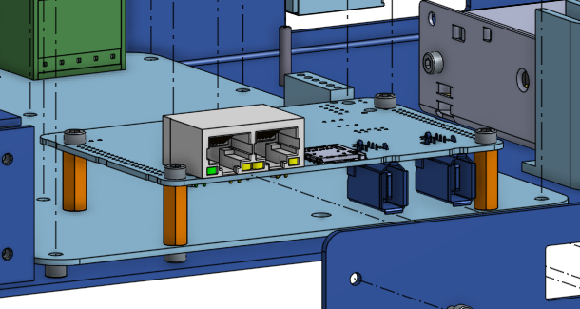
Attach FPGA to dRAC
Record the serial numbers of FPGA and dRAC.
Plug 102 FPGA into 101 dRAC in direction below. Check that pins are aligned.
Use 8 M3x5 screws and 4 M3x16 standoffs to connect 4 pairs of screw holes. Use thread locker.
M3x5
301
102
101
308

Slide 24
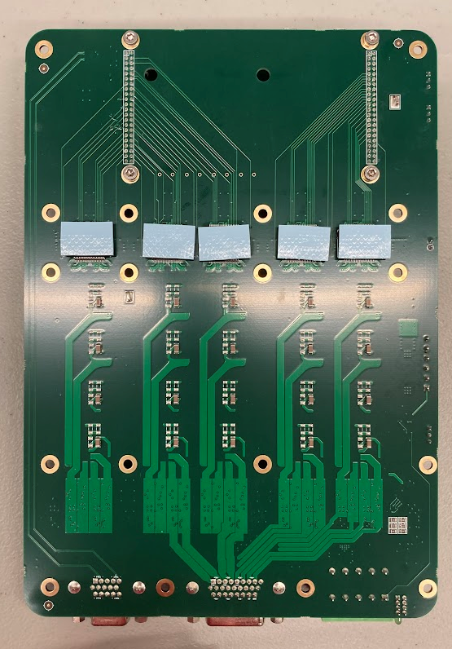
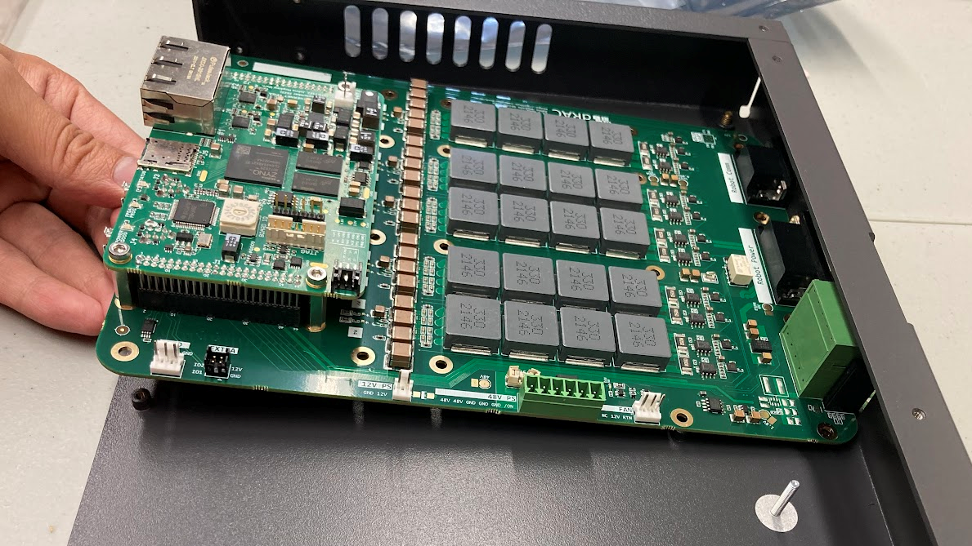
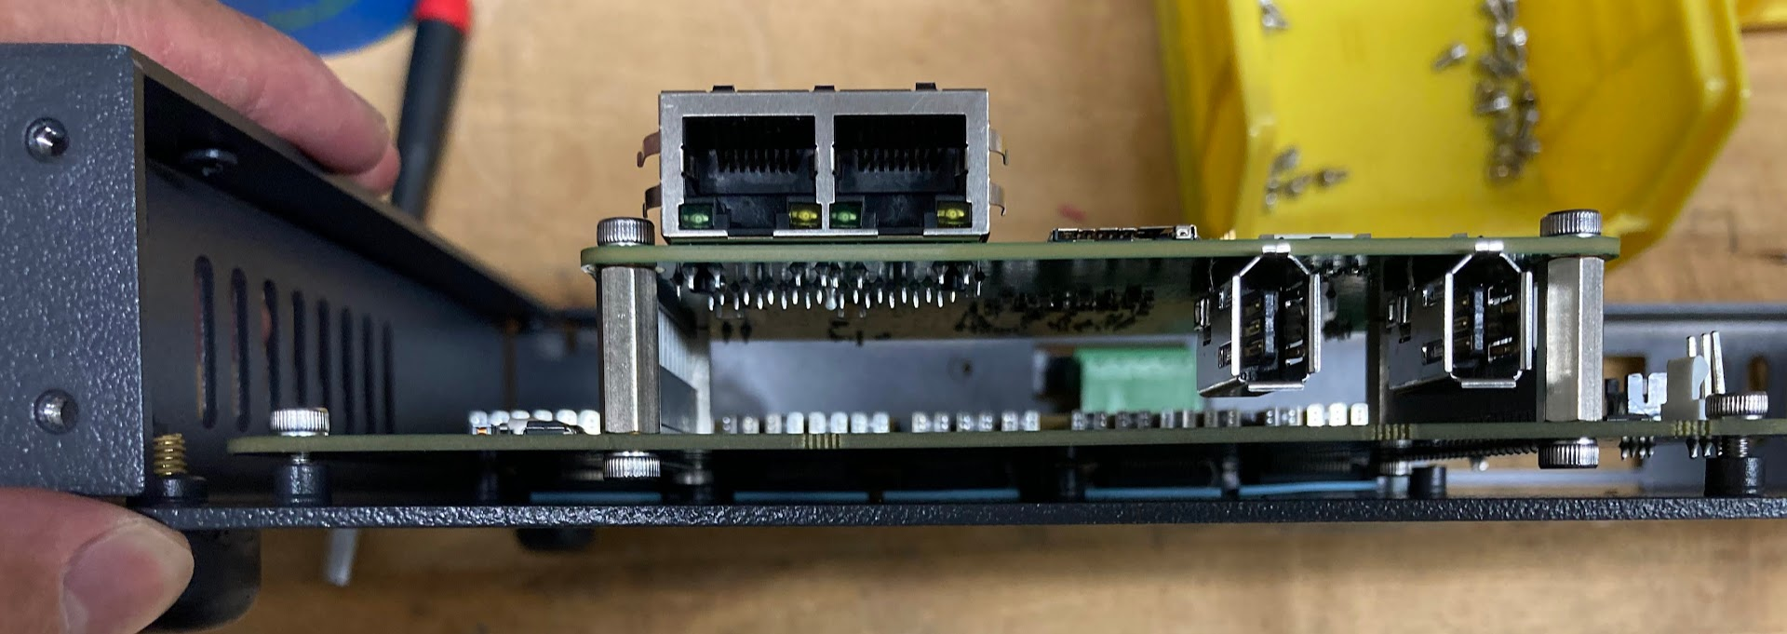
Step 2: Install dRAC
Apply 5 pieces of TIM (thermal interface material) 108 to the ICs on the back side of dRAC. Make sure plastic film on both side of the TIM are removed.
Put dRAC in enclosure. Tilt dRAC and let connectors go through the opening in the enclosure first. Make sure the TIM does not fall off in the process. Holding the enclosure vertically may help.
Once dRAC is seated and screw holes aligned, peek between dRAC and enclosure to confirm TIM are correctly positioned.
101
108

Slide 25
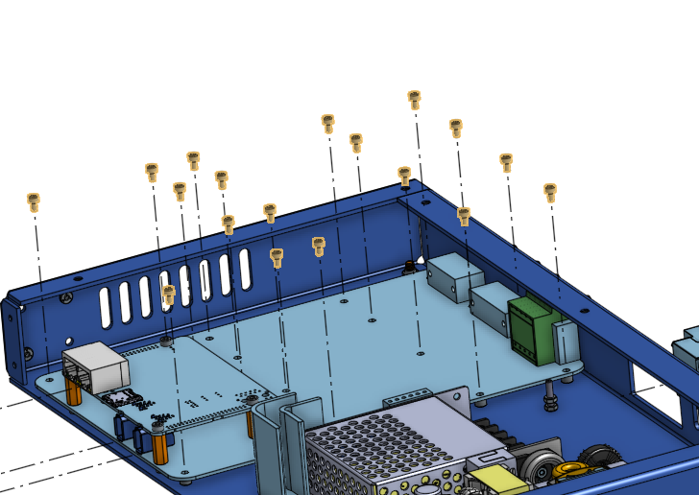
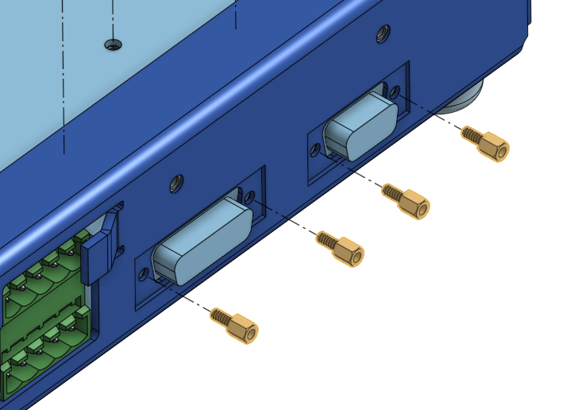
Step 2: Install dRAC
M3x5
301
201
307
Install all screws (M3x5) and earth wire. The one marked in red should go through one end of a 201 earth wire. Install all D sub screwlocks.
Avoid excessive stress on the PCB. Consider loosely installing all screws and screwlocks before fully tightening.
Some screws require a ball-end allen wrench to reach.

Slide 26
Step 3: Install power supplies
Use screws to attach 12V PS, 48V PS to the enclosure.
Snap fit power entry module. Note the orientation. Switch power on position should be up. Label should be up.

Slide 27
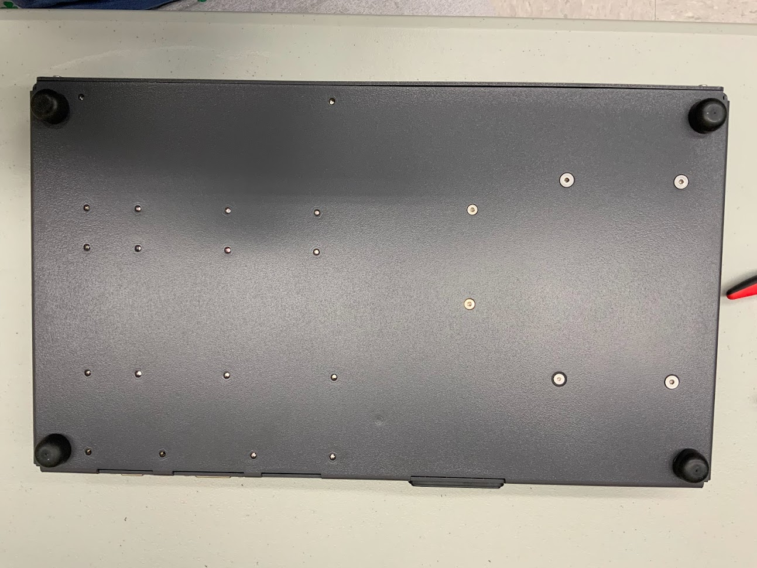
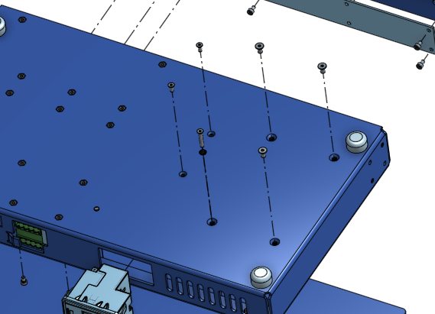
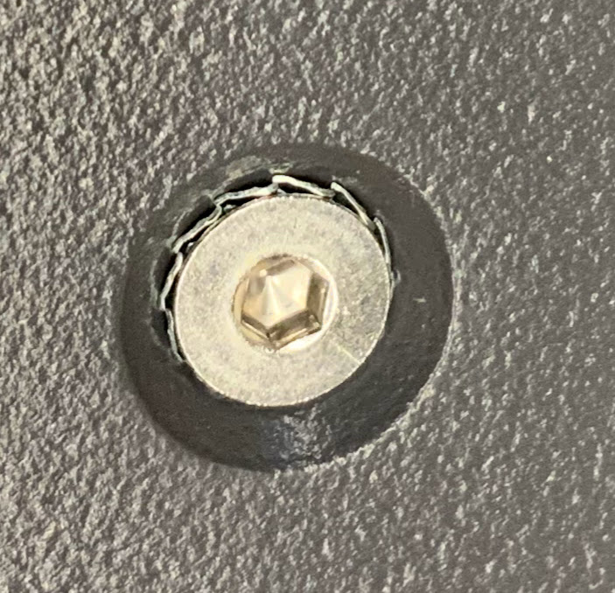
Use screws to attach 12V PS, 48V PS to the enclosure.
M4x5
Countersink
M4x5
Countersink
M3x5
Countersink
M3x5
Countersink
M3x20
Countersink
M4x5
Countersink

Slide 28
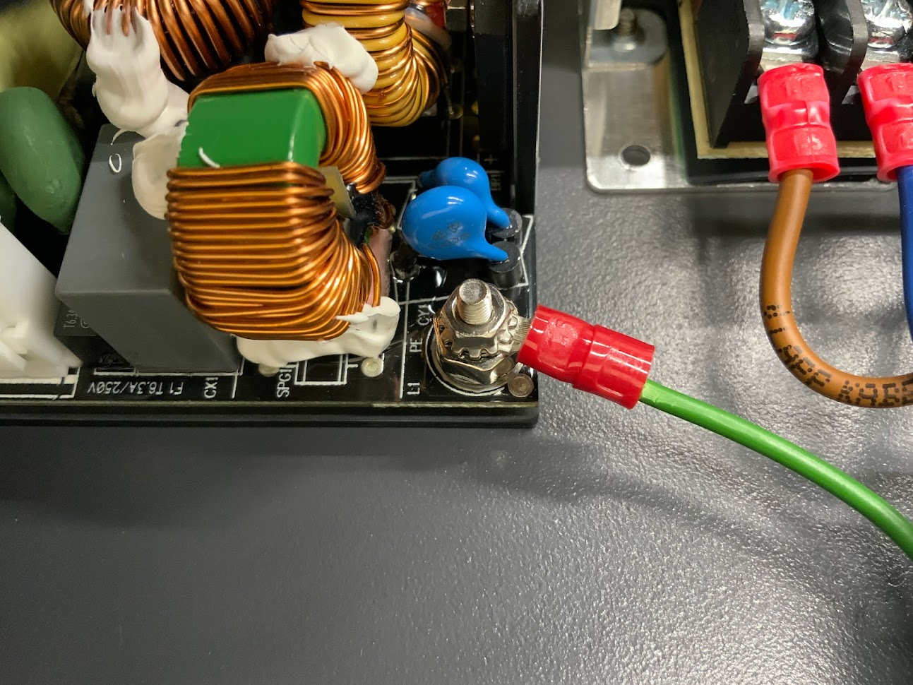
Note - 48V PS Earth connection
M3x20 countersink screw
303
M3 lock nut
305
M3 countersink lock washer
202
M3x20
306

Slide 29
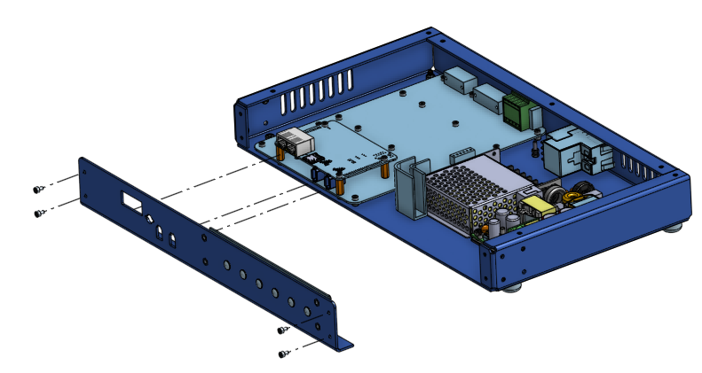
Step 4: Attach the front panel
M3x5
301
The connectors on FPGA should fit in front panel openings.
Loosely install the 4 front panel screws M3x5. Do not tighten.

Slide 30
Step 5: Wiring
201
203
204
202
201
205
206
207

Slide 31
Detail: stack up at the earth post:
Nut
Ring terminals
305
Detail: On the power entry module, the top pin is neutral (blue). The bottom pin is line (brown). The middle two pins are not connected. The right side pin is earth.
Note: 48V wires should go through the wire guide.

Slide 32
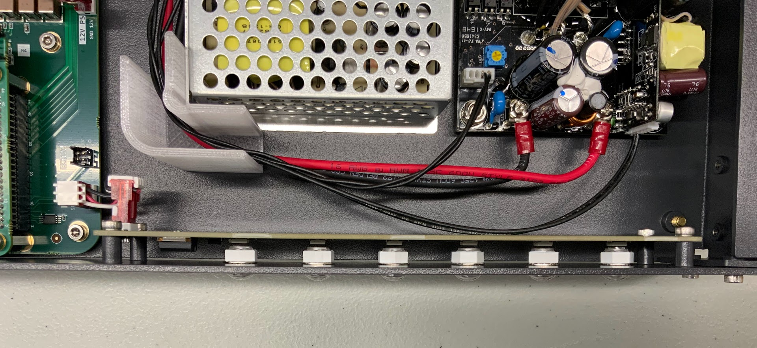
Note: make sure these terminals don’t touch the capacitor and inductor on the 48V power supply. You can use a plastic spudger as a spacing tool when tightening the terminal screws.

Slide 33
Detail: Location of the 4-pin and 6-pin JST connectors. The 6-pin JST connector has a jumper that needs to be removed before plugging in the connector.

Slide 34
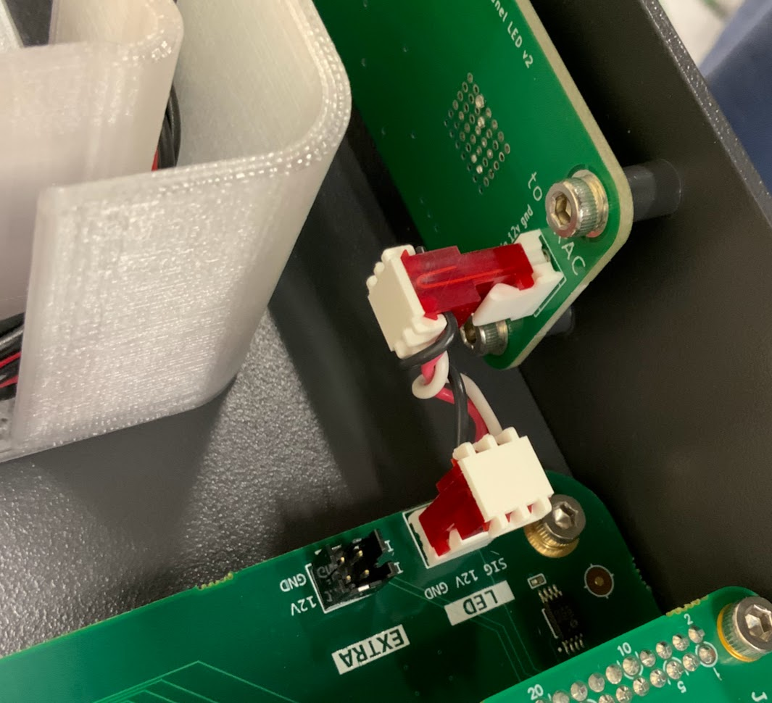
detail: front panel to dRAC wiring

Slide 35

Step 6: MicroSD Card
Insert MicroSD card 110 into Test PC
Unzip contents of embedded software onto MicroSD
Remove MicroSD from Test PC and insert into slot on front of enclosure
110
Not to scale

Slide 36
Step 7: Labels and Misc.
Install 2 fuses 109 in the power entry module
Set board ID. Attach board ID label to front of enclosure
Attach serial number label with following information to rear of enclosure:
dVRK Si Controller
SN SAx-n (x is the build number and n is the unit number, e.g., 01-99)
yyyy-mm (year and month of assembly)
Record the serial numbers of FPGA and dRAC
Attach feet to bottom of enclosure
You can test the controllers at this point.

Slide 37
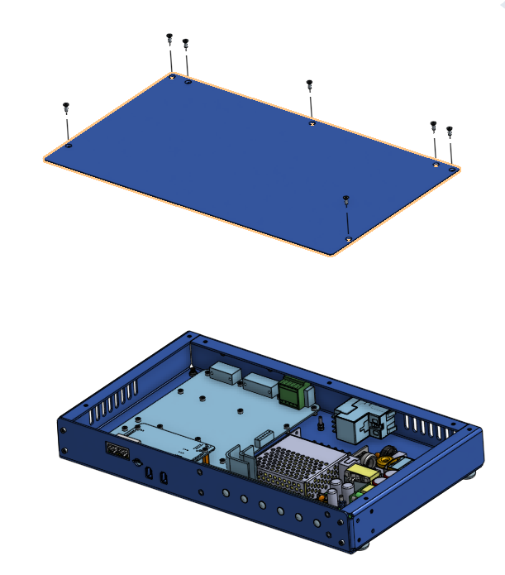
Step 8: Top panel
Tighten the screws on top panel (M3 countersunk phillips screws provided by Protocase)
Tighten 4 front panel screws
Do not reverse the order. Otherwise the top panel will be difficult to fit.
Once the front panel screws are tightened, top panel can be removed and reinstalled without the need to loosen the front panel screws.

